Slide 1

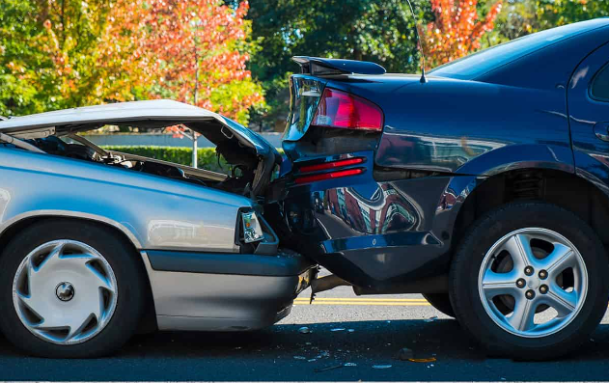
FRAUDULENT CLAIM ON CARS PHYSICAL DAMAGE
Presented by: Mr.Gaurav R. Khumkar

Slide 2





INTRODUCTION
The data we have shows information about drivers, their vehicles, accidents, and insurance details. This information can help us understand why people make insurance claims and if any fraud is happening.
It's useful for insurance companies, regulators, and researchers who want to knaow more about insurance claims and risks.

Slide 3



PROBLEM STATEMENT
The big question we're trying to answer using this data is how to predict when someone will make an insurance claim and how to find cases where someone might be pretending to make a claim when they shouldn't be.

Slide 4
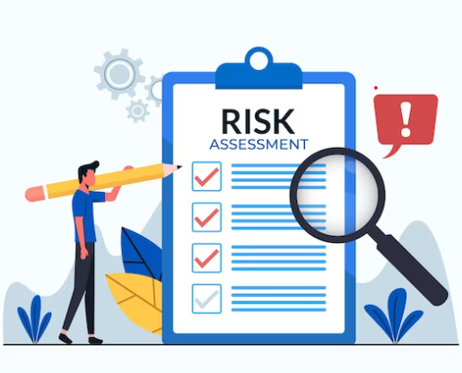
OBJECTIVE
CLAIM PREDICTION
FRAUD DETECTION
RISK ASSESSMENT

Slide 5

DATA
Collect Data From
https://www.kaggle.com/datasets/surekharamireddy/fraudulent-claim-on-cars-physical-damage
Import Data
Import Data In Python From Pandas Library

Slide 6
Age of Driver: The age of the person who drives the car.
Gender: Whether the driver is male (M) or female (F).
Vehicle Price: How much the vehicle is worth.
Safety Rating: A measure of how safe the driver is.
Witness Present Indicator: Whether there was someone who saw the accident (1 for yes, 0 for no)
Marital Status: Whether the driver is married (1.0) or unmarried (0.0).
Annual Income: How much money the driver earns in a year.
Address Change Indicator: Whether the driver recently changed their address (1 for yes, 0 for no).
Living Status: Whether the driver rents or owns their living space.
Accident Site: Where the accident happened, like local roads or highways.
Past Number of Claims: How many times the driver has made an insurance claim before..
Liability Percentage: The percentage of responsibility the driver has for the accident.
Channel: How the insurance was bought, like through a broker, online, or over the phone.
Policy Report Filed Indicator: Whether a report about the incident was filed (1 for yes, 0 for no).
Claim Estimated Payout: An estimate of how much money the driver might get from the insurance claim.
Age of Vehicle: How old the insured vehicle is.
Vehicle Category: The type of vehicle, like compact, large, or medium.
Vehicle Weight: How heavy the vehicle is.
Fraud Indicator: Whether there's a suspicion of fraud (1 for yes, 0 for no).
FEATURE UNDERSTANDING

Slide 7

MODEL BUILDING
5
Split Data into
(Train Test )
1
Collect Data
6
Build Model On
(Training Data)
2
Import Data
7
Evaluate
Model
3
EDA
(Exploratory Data Analysis)
8
Deploy Model
4
Feature
Engineering

Slide 8


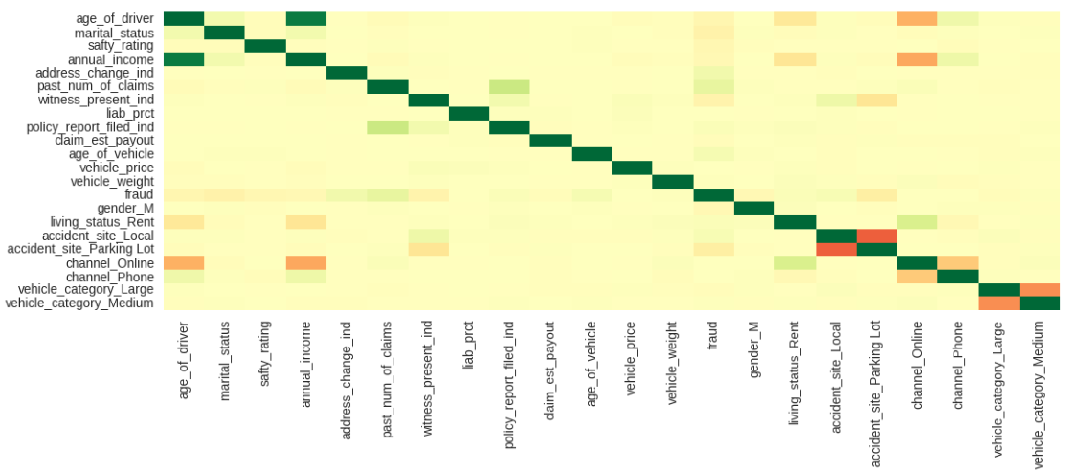
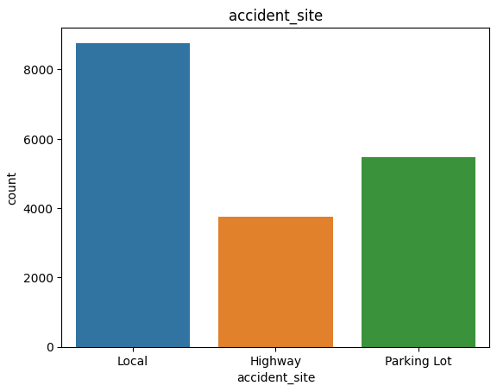
EDA(Exploratory Data Analysis)
Data Cleaning
Data Visualization
Analyzing Relationship Between Data

Slide 9






FEATURE ENGINEERING
Encoding
Scaling
Data
Balancing
Data
Feature Selection

Slide 10
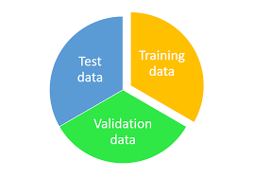
SPLIT DATA
80%
Training Data
Use To Trained
Algorithm
20%
Testing Data
Use To Predict
ML Algorithm

Slide 11

IMPLEMENTED ALGORITHMS
Logistic Regression
Decision Tree
Random Forest
Naive Bayes
Support Vector Machine
Gradient Boosting
XG Boosting

Slide 12
AUC
TO CHECK ACCURACY OF MODEL
TPR,FPR
RECALL
TPR,FPR
Recall
SPECIFICITY
PRECISION
Specificity
Precision
ACCURACY
SENSITIVITY
Accuracy
Sensitivity
CONFUSION MATRIX
AUC
ROC
ROC

Slide 13
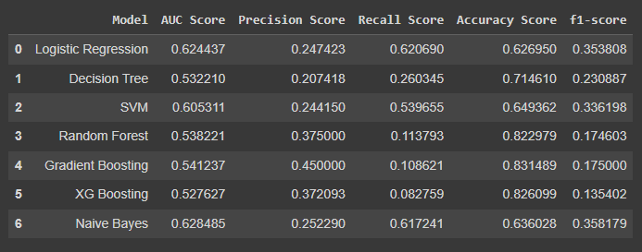
CONCLUSION
The Model we use for Prediction is GRADIENT BOOSTING.

Slide 14
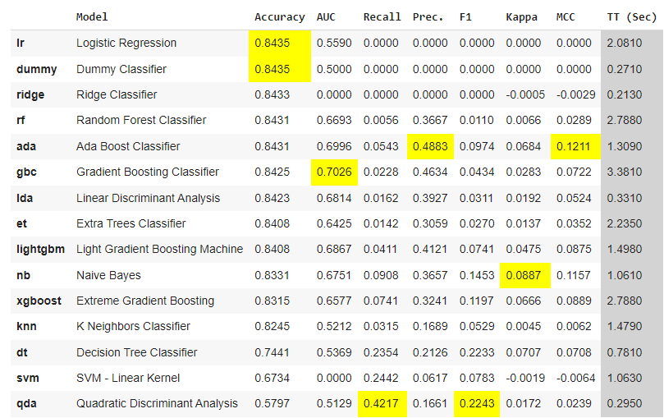
AUTO ML
PYCARET

Slide 15
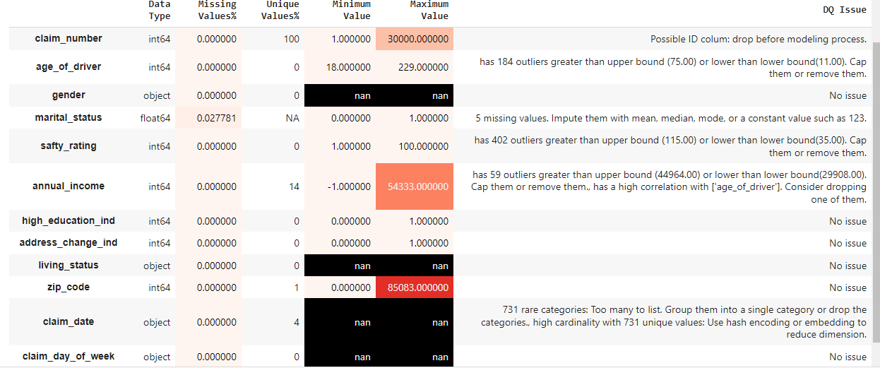
AUTO EDA
AUTOVIZ

Slide 16





THANK YOU
+91-9867771379
gauravkhumkar1379@gmail.com

